Slide 1

Learning To Edit Code
Ph.D. Defense Presentation
Saikat Chakraborty
Department of Computer Science
Columbia University.
July 26, 2022
Committee
Dr. Gail Kaiser (Chair), Columbia University
Dr. Baishakhi Ray (Adviser), Columbia University
Dr. Kathleen McKeown, Columbia University
Dr. Junfeng Yang, Columbia University
Dr. Kai-Wei Chang, University of California at Los Angeles
Notes:
Hi everyone, welcome to my dissertation presentation. My name is Saikat Chakraborty. My dissertation is on Learning to Edit Code

Slide 2
Automatic Code Editing
Notes:
Let me start with a life story. Before joining the PhD program, I briefly worked as a Junior Software Engineer in company with large code base.

Slide 3
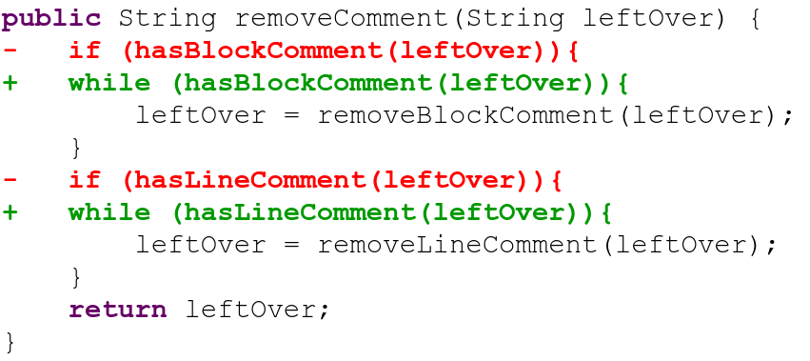
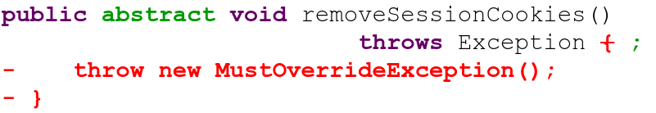
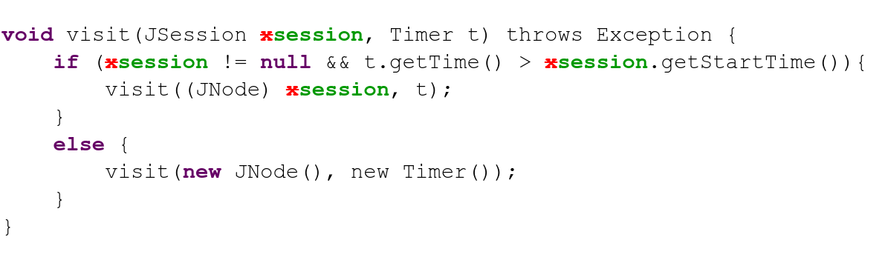
Adding Feature
Bug-fixing
Refactoring
Notes:
As a Junior Software Engineer, I modified the existing code in that company’s codebase to add new feature,
To Fix bugs
To refactor, etc.

Slide 4
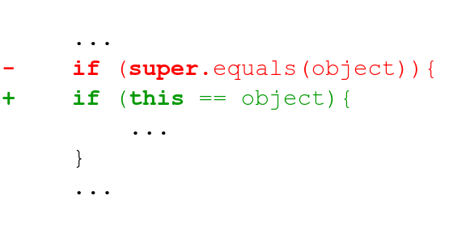
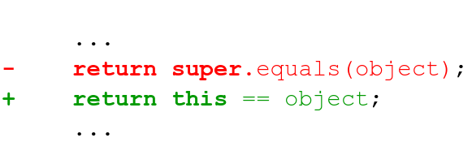
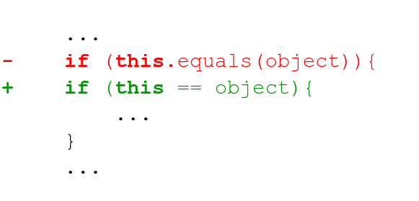
Code Edits Are Repetitive (Meng et. al. 2011[1], 2013[2], Ray et. al. 2015[3])
Is it possible to
Automate
Such Code Edits?
Notes:
I realized that the edits I have been making in that job follow specific patterns and thus very repetitive. In fact several earlier works also showed that the developers edit patterns are not unique, there are lots of repetition.
That raises a good question, Can we automate such code edits?

Slide 5
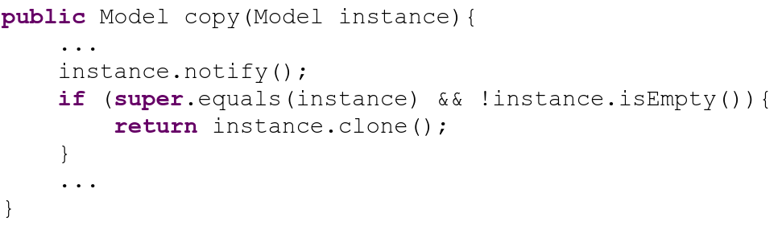
Automating Code Edits - Template/Search based
Edit Template
Match Found
Notes:
One possible way to automate code edit is to manually write edit template.
Then search for application site for that template in the code base
Once there is a match

Slide 6
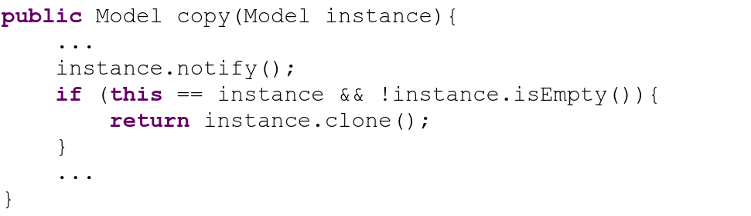
Automating Code Edits - Template/Search based
Edit Template
Patch Applied
Problems
Too many templates to write.
Bottleneck : Template Matching / Code Search
Notes:
We can apply the patch.
However, such an approach has one problem, these templates are often hand-coded and very tedious. Also, efficacy of this approach highly depends on code search and template matching success.

Slide 7
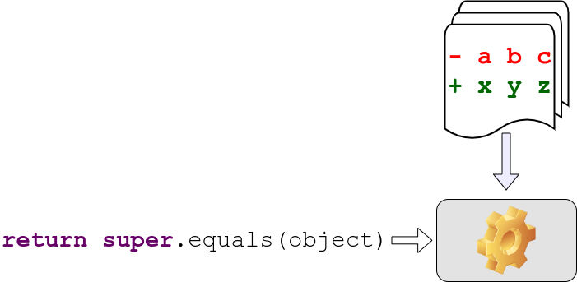
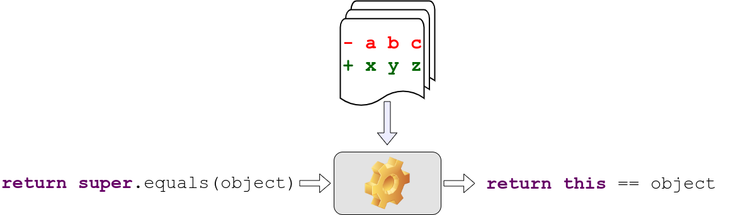
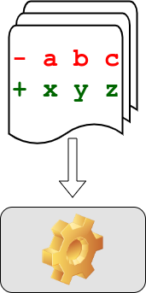
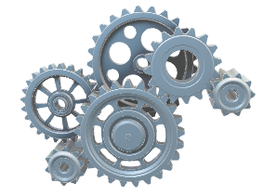
Code Editing Task - Learning Based Solution
Example Code Edits
Code Before Edit
Code After Edit
Notes:
Another way to solve this problem is to learn such Edit patterns.
In this solution, we train a machine learning model to learn code edit patterns from example edits.
After training, the machine takes in the Before Edit Version of the Code and
Translates it to Edited code, applying the changing pattern in the process.

Slide 8
What are my Contributions?
Application in Automatic Program Repair and Other SE tasks.
3
Development of both Automated Code Editor.
2
Identification of Technical Challenges in Learning based Code Editing.
1
Notes:
In my dissertation, I researched on building machine-learning-based solutions for automatic code editing. With that being said, let us quickly go over the high level contribution I am going to make through my dissertation.
First, I identify the technical challenges to design a learning based code editing system.
Secondly, I work through those challenges to develop and build semi-automatic or fully automatic code editor.
And finally, I apply such tools for real world developments, for instance, automatic program repair. While working towards solving this problem, I built models that are useful in other software engineering tasks as well.

Slide 9
Automated Code Editing - Existing works.
Template-based
Modern IDE (Eclipse, IntelliJ IDEA) - Refactoring, Boilerplate Code.
Meng et.al. - PLDI’11 - Infer edit template with graph matching [1].
Mutation Learning
Rolim et. al. - ICSE’17 - Designed a DSL for representing Edits [4].
Dinella et.al. - ICLR’20 - Neural Turing Machine [5].
Encoder-Decoder
Tufano et. al. - ASE’18 [6], ICSE’19 [7], TOSEM’19 [8]. - Abstract tokenization.
Chen et. al. - TSE’19 - Copy Attention-based models [9].
Tufano et. al. - ICSE’21. - Multi-Encoder models[10].
Notes:
With that being said, let us quickly go over the existing works in automated code editing.
I divide the existing solutions in automated code editing into three broad categories. First Template based solutions where edit templates are manually written or mined from data. Modern IDEs use such approaches for refactoring and adding boilerplate code.
Second category are mutation on code is learned. Given a piece of code, a machine predicts most probable edit operation. And a machine learns to predict sequence of such edit operations to edit the original code to the final code.
Last, but not the lease, and this is the sub-area I concentrated my research on, is Encoder-Decoder based techniques. Where the Code Editor works like a code translator and apply the edit pattern in the form of translation. Throughout my dissertation, I formulated the problem of automated code editing as encoder-decoder based translation model.

Slide 10
Encoder-Decoder
Based Code Editing
Notes:
Now, let us look details into Encoder-Decoder based Code Editing?

Slide 11
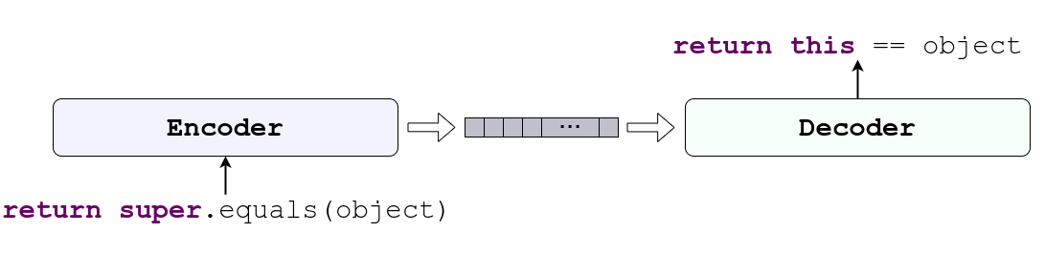
Code Editing with Encoder-Decoder
Encoder and Decoder learns
Code Edit Patterns from example edits.
Notes:
The Encoder-Decoder based code editor is a machine learning model which consists of a Code Encoder and Code Decoder.
Together they can learn the edit patterns from example edits and

Slide 12
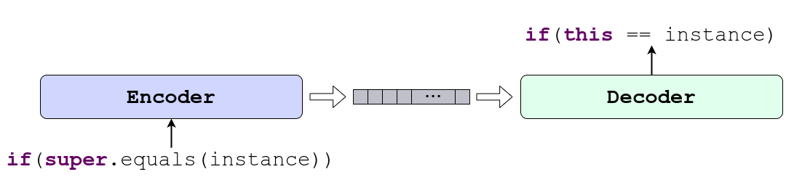
Code Editing with Encoder-Decoder
Encoder and Decoder learns to
Apply the Pattern in Similar Context.
Notes:
Once the encoder and the decode learns the edit patterns, they can apply the patterns in similar context. Now let us look at how the encoders and decoders work.

Slide 13
Code Editing with Encoder-Decoder
Encoder encodes the input code to a vector or matrix.
Decoder generates the edited code.
Notes:
The encode takes in the code before edit and encodes it to a vectorized representation
The decoder then generates the edited code from those vectorized representations.

Slide 14
Encoder-Decoder Based Code Editing
Where does my dissertation stand?
Notes:
Now that we formally defined encoder decoder based code editors, let me compare my contribution with respect to some of the existing techniques that uses encode-decoder based methods.

Slide 15



Method | Concrete Code | Syntactic Correctness | Contextual Correctness | Code Naturalness | Multi Modality
M. Tufano et. al. ASE 2018 [6], ICSE 2019 [7]
SequenceR - Chen et. al. TSE 2019 [9]
CODIT - TSE 2020
CodeBERT - Feng et. al. EMNLP 2020 [11]
PLBART - NAACL 2021
CoCoNut - Lutellier et. al. ISSTA 2020 [12]
R. Tufano et. al. - ICSE 2021 [10]
MODIT – ASE 2021
NatGen – FSE 2022
Used/Guaranteed
Not Used
No guarantee
Empirical guarantee
Notes:
Here I list some existing techniques and evaluate four different properties of those techniques. The first category is whether or not the editor can generate concrete code, or just a template. If a method cannot generate concrete code, it may not be used as automated code editor. Second, I check whether the edited code is syntactically correct, third whether it is contextually correct. And finally, whether those approaches are capable of handling multi-modal information that is different source of input information.
Among these CODIT, which is published in TSE 2020, PLBART, which is published in NAACL 2021, and MODIT, which is a work in progress are going to be part of my dissertation.
As I am designing techniques for source code analysis, I should consider the properties of the source code, and let us revisit what properties of the source code should we consider while building such a model.

Slide 16
Desired Properties of
Encoder and Decoder
Notes:
In particular, let us recap what properties should the encoder and the decode exhibit. But Let us look at different properties of code first.

Slide 17
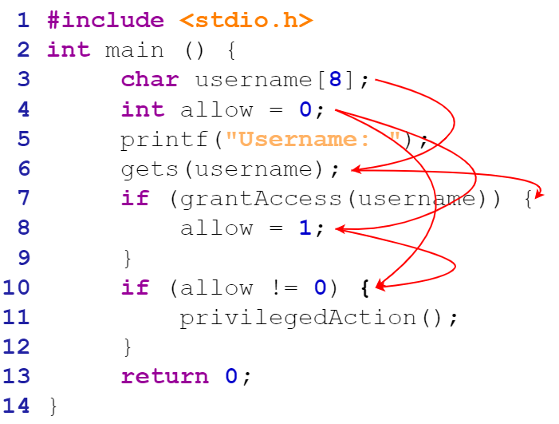
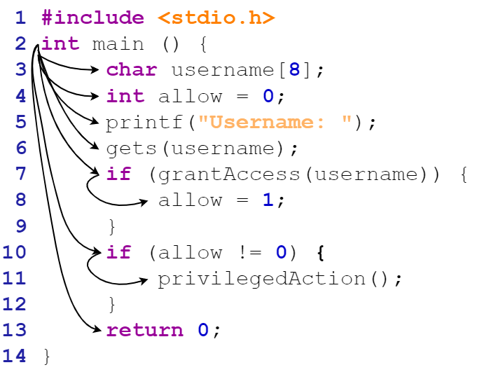
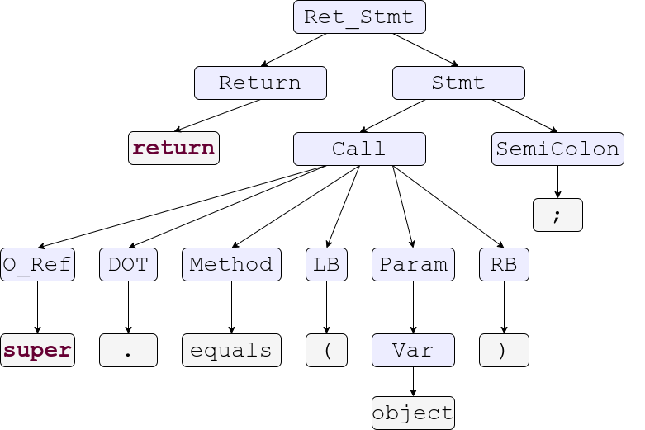
Properties of Source Code.
Control Dependency
Syntax Structure
Data Dependency
17
Notes:
A model trying to understand the input source code should understand the basic structure of the input code,
that is the syntax structure, the syntax tree or the abstract syntax tree.
Beyond that, the model should understand the semantic structure consisting of Control Dependencies
Data dependencies, etc.

Slide 18
Desired Properties of the Encoder
Source Code
Encoder
Understand
Long Range Relations
Understand Structure
Understand Dependency
Notes:
Thus, To fully understand the code through an encoder, the encoder model should
Understand the structure
Understand the dependency
And understand the long range relations. Now we will see the properties of the Decoder

Slide 19
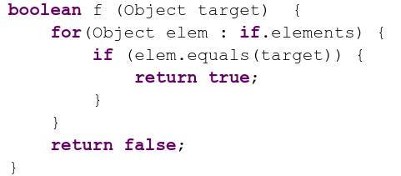
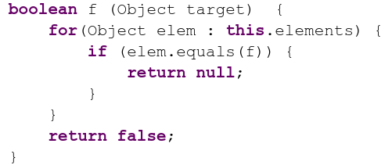
Desired Properties of the Decoder
Syntactic correctness.
Contextual correctness.
Decoder
Syntactically Incorrect
Contextually Incorrect
Notes:
Since the Decoder is essentially a code generator, It should ensure syntactic correctness and semantic or contextual correctness. To understand up what I meant by these correctness properties, let us look at some counter examples.
This is a syntactically incorrect code. Because
Of this misplaced if token. If a model makes one such mistake, the whole code is practically useless.
This code is contexually incorrect because
A function name is passed as parameters of another function.
Also, even though the return type of the function is boolean, the generated function is returning null. When these code are passed through a compiler, the first one will result in a syntax error by the compiler, and the second one will result in a semantic error. Nevertheless, now that we know the bar of expectation from both the encoder and decoder, let us dive into my research.

Slide 20
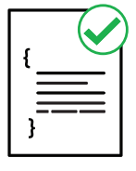

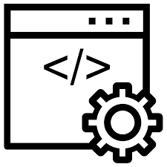
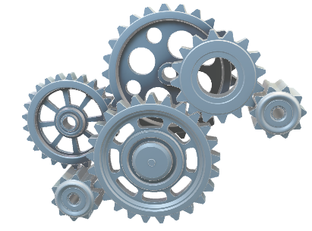
Code Editing as Understanding and Generation
Understanding
Source Code
Syntax
Understanding Structure
And Functionality of Source Code
Generating
Source Code
Encoding
Ensuring the Syntactic and Semantic Correctness for Generating Source Code
Semantics
20
Notes:
Thus, this dissertation deconstructs the problem of automated code editing into two sub-problems. That is understand the code and generating the code.
Since we are concerned about the syntactic and semantic properties of source code, the main goal of my research is to design model to encode such programming language properties into the code.

Slide 21
Encoding PL Properties
Syntax
Code Modeling
Explicit Encoding
Implicit Encoding
Natural Channel Mutation
Formal Channel Mutation
Ways of Encoding
Semantics
21
Notes:
In my research experience, I see several ways to do so. On one hand, we can explicitly design models to exhibit PL specific constraints. On the other hand, we can implicitly learn these constraints from large amount of data. I have worked on both of these directions. And in today’s talk, I will discuss some of my works in these directions. Is there is clarification question so far?

Slide 22
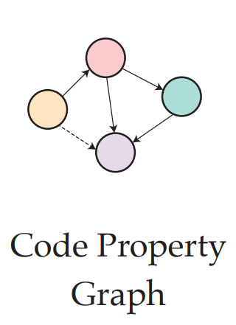
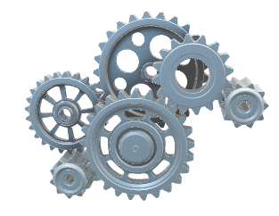
Explicit Encoding
Code Modeling
Explicit Encoding
Implicit Encoding
Natural Channel Mutation
Formal Channel Mutation
[13] Learning to Represent Program as Graphs
Allamanis et. al. 2017
[14] Learning to Represent Edits
Yin et. al. 2019
[5] HOPPITY – Dinella et. al. 2020
22
Notes:
First off, the explicit encoding.
In this approach, we specifically design the model to address the PL constraints or PL specific properties. There are a lot of related works in last few years in this direction. Let us look at some of my work in this direction.

Slide 23
CODIT: Code Editing With Tree Based Neural Models
TSE - 2020
Findings
Generation of Syntax Tree instead of code Guarantees Syntactic Correctness.
Contribution
Tree/Grammar Based Model for Automatic Code Editing.
Notes:
The first component of my dissertation is CODIT: Code Editing with tree based neural models published in TSE 2020
Our major finding in this paper is the Generation of Syntax Tree instead of code Guarantees Syntactic Correctness. And it can be achieved with the help of Context Free Grammar of the Programming Language.
Our major contribution in this paper is that we designed a hierarchical Syntax Tree based model for learning code edit patterns.

Slide 24
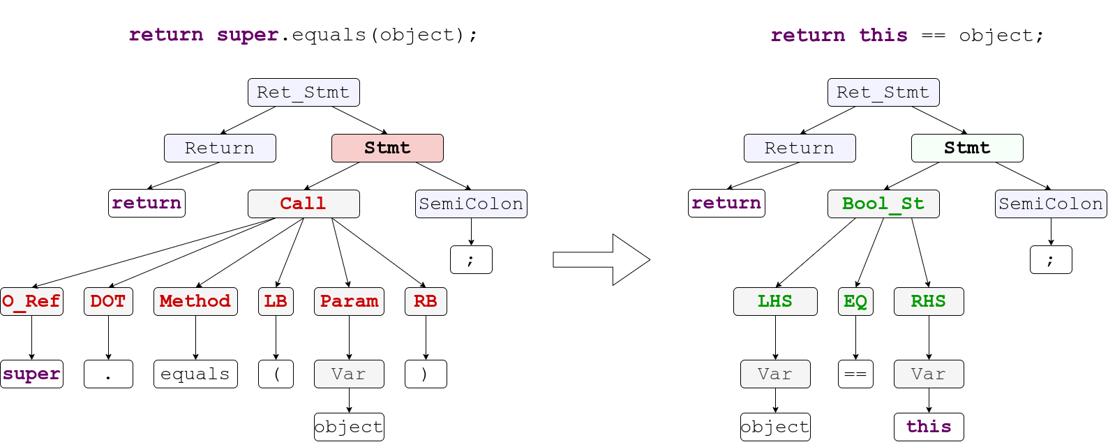
CODIT: Code Editing With Tree Based Neural Models
Code Before Edit
Code After Edit
24
Notes:
This is our first approach for this automation. And here our goal is to generate syntactically correct code. To ensure the syntactic correctness, we design a Tree Based model for code generation.
Concretely, Given the code before edit,
We extract the syntax tree out of it.
We then design a tree translation model to translate the syntax tree
And finally we generate the edited code from the syntax tree. As we will see later, Codit works in two steps.
In first step, Codit translates the structure, and
in second step Codit generates the Edited code.

Slide 25
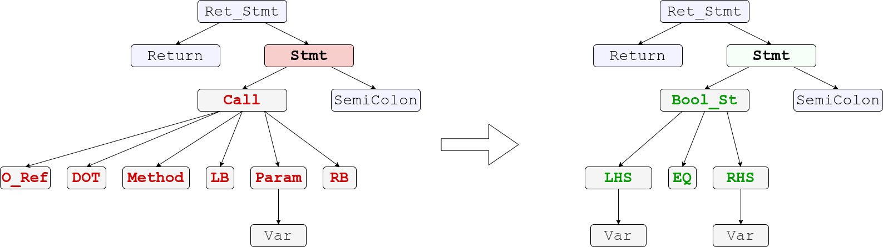
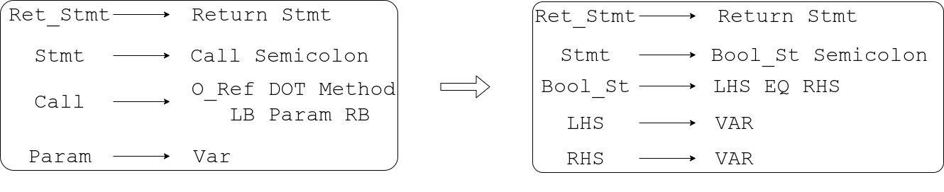
CODIT Step 1 : Tree Translation
Notes:
Thus, essentially by translating sequence of rule, we are translating the structure of the code and ensuring that the generated structure is syntactically correct.

Slide 26
CODIT Step 2 : Token Generation
Token Translation
Notes:
However, so far we only translated the structure. The full edited code is not ready yet. We still have to populate the terminal nodes with tokens.
To generate tokens, we design a CONDITIONAL token translation model, where we restrict the search space for every token based on the terminal node type from the tree.
For instance, in case of the terminal EQ, the only possible token to generate is the equality operator.

Slide 27
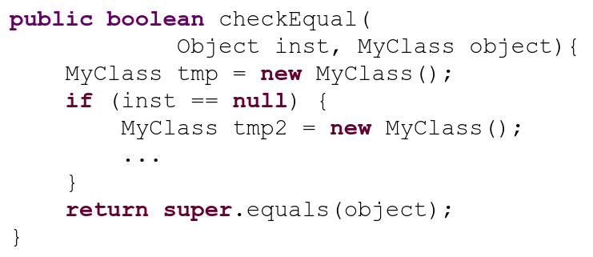
CODIT Step 2 : Token Generation
Reachable Variables in Edit Location:
{inst, object, tmp}
Reachability Analysis in Edit Location
Notes:
However, in case of variables and method names,
it becomes a little bit tricky, since possible number of names of the variable, and methods can be virtually infinite.
To solve this problem, we perform reachability analysis in the Edit location.
We only use those variables and method names that are reachable in the edit location. For instacce, for generating this edit, CODIT only considers these variables.

Slide 28
CODIT
Evaluation
Notes:
Now let us move on to the evaluation of Codit

Slide 29
CODIT: Study Subjects
Data Set | Number of Projects | Number of Edit Examples | Code Fragment Size
 |  |  | Number of Tokens | Number of Nodes
Generic Code Edit from Github | 48 | 32,473 | Max - 38 Avg - 15 | Max - 47 Avg - 20
Pull Request Edits –Tufano et al. [7] | 3 | 5546 | Max - 34 Avg - 17 | Max - 47 Avg - 23
Notes:
We evaluated codit on two different datasets. First one generic code edit from github which contains 48 projects a little more than 32 thousand edit examples. And next is pull request edits with 3 projects and five and a half thousand edit examples.

Slide 30
CODIT: Results (Accuracy in top 5)
Method |  | Generic Code Edits | Pull Request Edit
Sequence Based | LSTM-Seq2Seq | 3.77% | 11.26%
 | Tufano et. al. [7] | 6.57% | 23.65%
 | SequenceR [9] | 9.76% | 26.43%
Tree Based | Tree2Seq | 11.04% | 23.49%
 | CODIT | 15.94% | 28.87%
Notes:
We evaluated Codit against two types of models. First we consider model where both encoder and decoder treats code a sequence of tokens. In this group, we have three baselines. LSTM-Seq2Seq is a vanilla LSTM based model. Next one of also LSTM S2S model working on abstracted code Tufano et. al. and the third one is SequenceR which a also a LSTM seq2seq model with copy attention.
To understand tree based modeling, we compared CODIT with a tree2seq model which uses a tree based encoder and sequence based decoder to generate edited code.
Codit promising result over the sequence based baselines shows the effectiveness of tree based modeling. Codit’s better performance over tree2seq model shows the importance of using tree based model both as encoder and decoder.

Slide 31
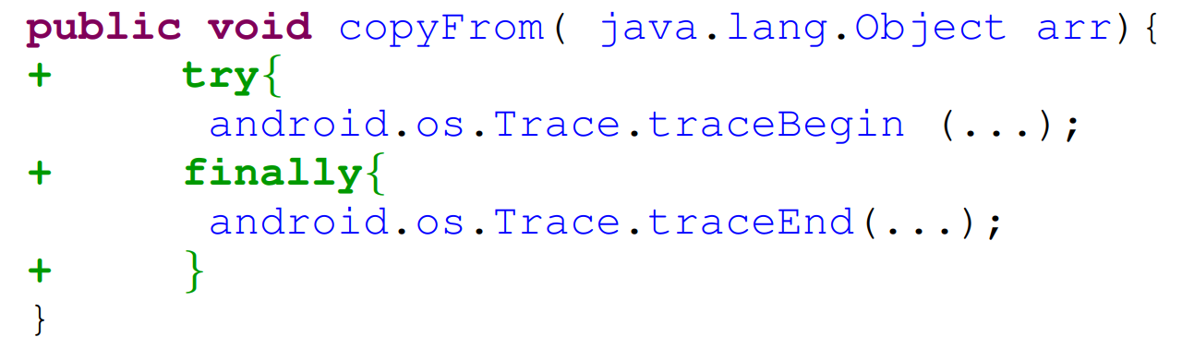
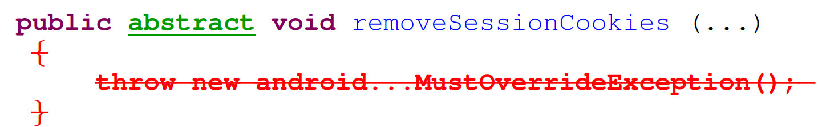
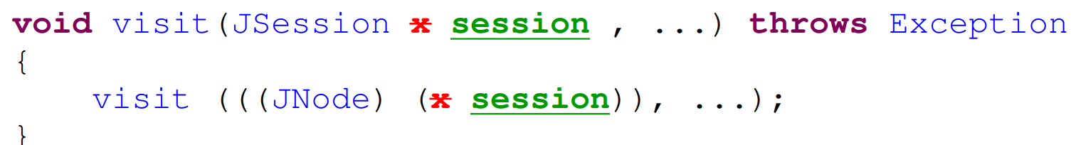
Example Edits
Addition
Deletion
Update
Notes:
Let us look at some example Edit Codit generates.

Slide 32
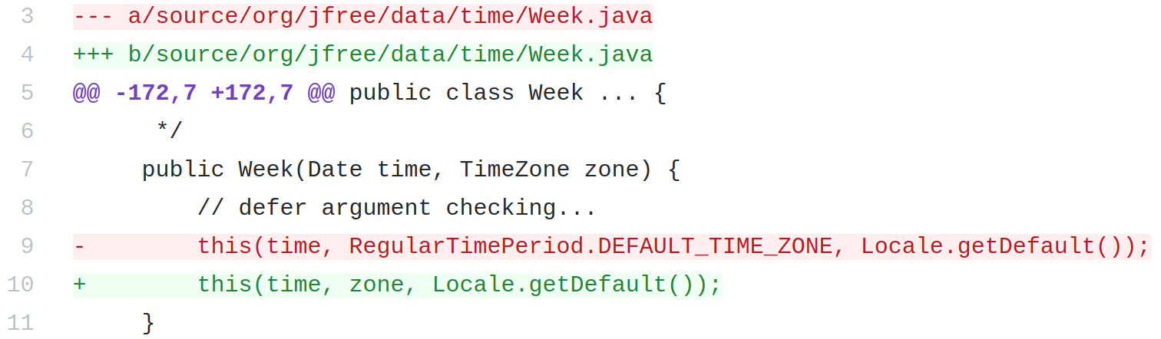
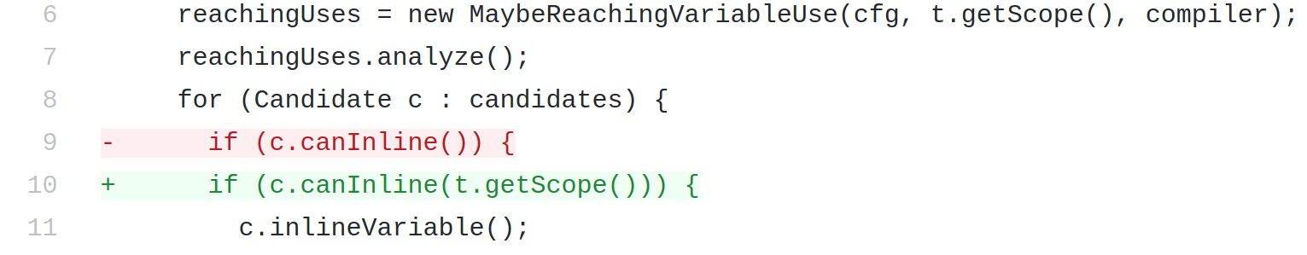
Application - Automatic Program repair
CODIT fixes 15 bugs completely and 10 bugs partially, out of 80 bugs in Defects4j.
JFreeChart: Bug-8
Closure Compiler: Bug-3
Notes:
We applied Codit for bug-fix code edits. Out of 80 bugs in defects4j dataset, Codit successfully fixed 15 bugs completely and 10 bugs partially,
And the graph shows how quickly Codit can generate patches that passes bug reproducing test cases. And within 20 minutes Codit generated patches 50 bugs that passes at least the bug reproducing test cases.

Slide 33
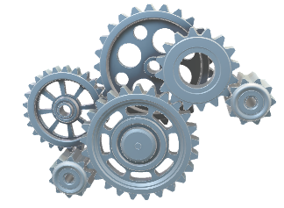
Explicit Encoding
Reachability Analysis
Context Free Grammar
33
Notes:
Now going back to the context of generative model in source code,
We embedded the one formal constraint form programming language THAT IS SYNTAX into the model EXPLICITLY in the form of probabilistic context free grammar and syntax tree.
Which we further improved with reachability analysis. Now that we saw example of Code Generation,

Slide 34
Explicit Encoding – Take Away
Code Modeling
Explicit Encoding
Implicit Encoding
Natural Channel Mutation
Formal Channel Mutation
Pros
Precision
Guarantee
Cons
Model design overhead
Transferability
Explainable
Low Resource
34
Notes:
Summing up the portion of Explicit encoding. The good side of explicit encoding is the precision, guarantee, and explainability.
However, these approaches often entails overhead in model design, a lot of customization. Usually a model build for a task under this category, is not easily transferrable to other task. Any further clarification questions?

Slide 35



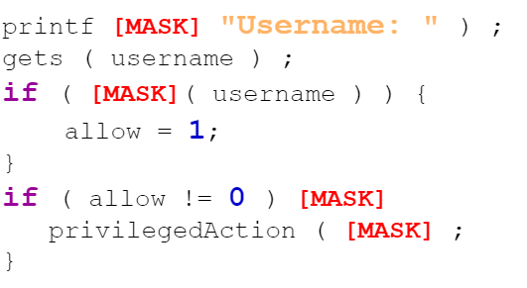
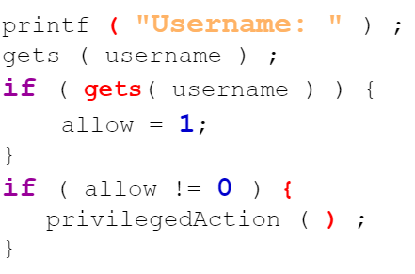

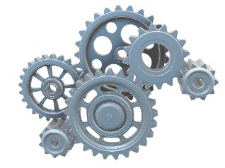
Implicit Encoding
Code Modeling
Explicit Encoding
Implicit Encoding
Natural Channel Mutation
Formal Channel Mutation
Large Data Corpus
Mutated Input
De-Mutation
[11] CodeBERT – Feng et. al. 2019
[16] GraphCodeBERT – Guo et. al. 2020
[17] CodeX – Chen et. al. 2021
[18] CodeT5 – Wang et. al. 2021
35
Notes:
Now let us see how we can implicitly encode PL properties in the model.
Usually these approaches entails the model learning from large curpus of data in an unsupervised way.
Typically, inputs from the data are mutated or deformed, and model is asked to either identify the deformation or fix the deformation. The idea is that, while doing such localization or repair, model learns about any potential underlying constraints prevalent in the data. This implicit encoding is the motivation behind PRETRAINING large scale models, and couple of such pretrained models are proposed in last few years. All of these models are aiming for better encoding the PL into the model, some with larger quantity of data, some with harder learning objectives etc. Nevertheless, before moving any further, let us go a bit off track and look into the code.

Slide 36

Implicit Encoding - Pretraining
Hundreds of Gigabytes of source code
Large Models (Millions of Parameters)
Large Data Corpus
Large numbers of unsupervised training steps
36
Notes:
Now let us see how we can implicitly encode PL properties in the model.
Usually these approaches entails the model learning from large curpus of data in an unsupervised way.
Typically, inputs from the data are mutated or deformed, and model is asked to either identify the deformation or fix the deformation. The idea is that, while doing such localization or repair, model learns about any potential underlying constraints prevalent in the data. This implicit encoding is the motivation behind PRETRAINING large scale models, and couple of such pretrained models are proposed in last few years. All of these models are aiming for better encoding the PL into the model, some with larger quantity of data, some with harder learning objectives etc. Nevertheless, before moving any further, let us go a bit off track and look into the code.

Slide 37
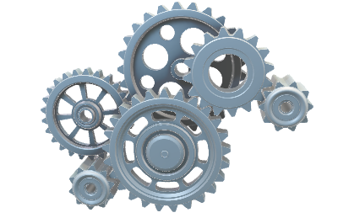

Implicit Encoding - Finetuning
Hundreds of Gigabytes of source code
Large Models (Millions of Parameters)
Large Data Corpus
Large numbers of unsupervised training steps
Input (e.g. Code before edit, Context, etc.)
Output (e.g. Code after edit
Finetuning
37
Notes:
Now let us see how we can implicitly encode PL properties in the model.
Usually these approaches entails the model learning from large curpus of data in an unsupervised way.
Typically, inputs from the data are mutated or deformed, and model is asked to either identify the deformation or fix the deformation. The idea is that, while doing such localization or repair, model learns about any potential underlying constraints prevalent in the data. This implicit encoding is the motivation behind PRETRAINING large scale models, and couple of such pretrained models are proposed in last few years. All of these models are aiming for better encoding the PL into the model, some with larger quantity of data, some with harder learning objectives etc. Nevertheless, before moving any further, let us go a bit off track and look into the code.

Slide 38
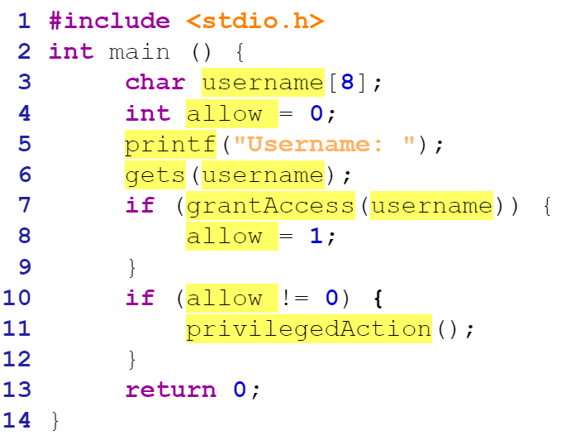
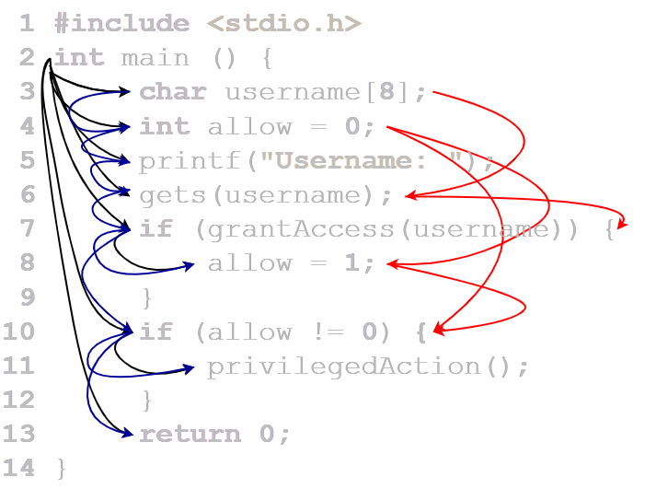
Dual Channel Hypothesis for Source Code [15]
Natural Channel [19, 20]
Formal Channel
[19] Casalanuovo et. al. 2020
[20] Karampatsis et. al. 2020
38
Notes:
Let us revisit the dual channel hypothesis in source code. In source code, there are two information channels.
First there is Natural Channel, consisting of human readable identifiers, readable formatting, comments, etc. This channel is mostly consumed by human developer.
Second, there is Formal channel, consisting of AST, Flow graphs, etc. This channel is mostly consumed by compilers or machines. Anyway, manipulation in the space of different channels will result in different concepts and constraints learned by a model. For instance, if we just remove the semicolons from a correct code and ask the model to fix, the model will only learn the appropriate position for the semicolons.

Slide 39
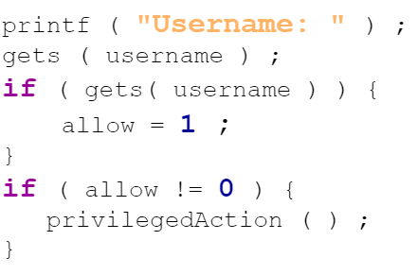

Implicit Encoding
Code Modeling
Explicit Encoding
Implicit Encoding
Natural Channel Mutation
Formal Channel Mutation
Mutator
39
Notes:
Nevertheless, In implicit encoding let us first look at encoding through natural channel mutation. Here typically while mutating the source code, we just consider the texts of the code, without going in details into the structure or semantics.

Slide 40
Unified Pre-training for Program Understanding and Generation (PLBART)
NAACL - 2021
Findings
Contextual Correctness can be learned from large scale source- code dataset.
Contribution
Developed large scale pre-trained models for different SE tasks.
Notes:
The paper I am going to discuss not us Unified Pre-training for Program Understanding and Generation (PLBART) accepted to be published in NAACL 2021.
Our contribution in this paper is that Developed large scale pre-trained models for different SE tasks.
The major findings in this paper is Contextual Correctness can be learned from large scale dataset. Now let us see some of the motivation behind PLBART.

Slide 41
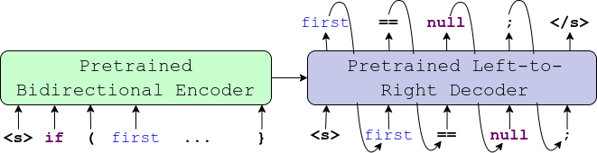
PLBART – What Is It?
Encoder
Decoder
Pretraining – Unsupervised way of learning code patterns.
Notes:
In a nutshell, PLBART is an encoder-decoder based model which is jointly pretrained to
Both Understand and generate code in an unsupervised way. We trained PLBART using hundred of gigabytes of source code and text.

Slide 42
PLBART – Components
Read Code.
Understands Code.
Reason about any errors in code.
Learns robust representation
Encoder
Decoder
Generate Code.
Learns Coding Patterns.
Notes:
Let us now look at the components of PLBART
The encoder in PLBART reads code, understand, reasons about any error and learn robust representation,
The decoder, on the other hand, learn to generates source code and implicitly learns any coding pattern from the data.

Slide 43
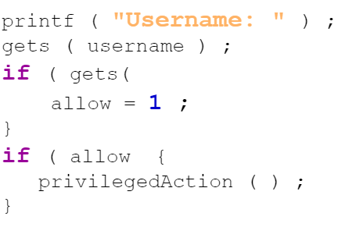
PLBART – Pretraining
Noise Injector
Correct Code
Noisy Code
Decoder
Encoder
PLBART
Token Masking
Token Deletion
Token Infilling
43
Notes:
We train PLBART using denoising autoencoding, an standard way to pretrain encoder-decoder model in NLP
given a code
A noise injector injects noise that could potentially break the syntax of the code
The encoder takes in such noisy code
And the decoder generates back the correct code. In that way, the encoder learns where is the error and what kind error is that, and the decoder learns how to generate error free code.
We use three types of noise function to mutate the natural channel in source code.

Slide 44
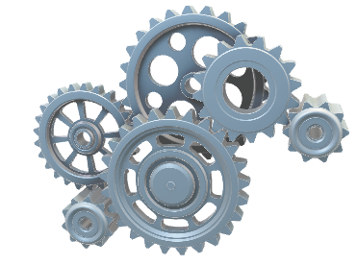
PLBART – Jointly Learning to Understand and Generate
Token Masking
PLBART
Notes:
First, we do token masking, we mask out some random tokens from a piece of code, and provide it to
PLBART, which then
Generates the whole code with appropriate tokens for those masked positions.

Slide 45
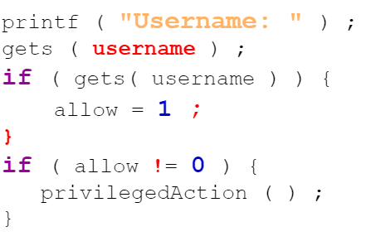
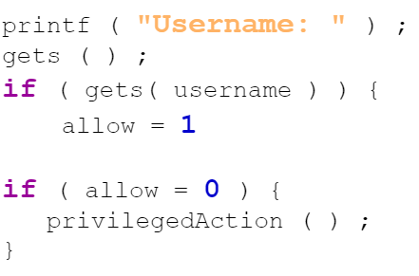
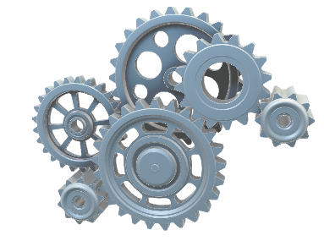
PLBART – Jointly Learning to Understand and Generate
Token Deletion
PLBART
Notes:
Likewise, For token deletion, we delete some random tokens, and
PLBART,
Generates the whole code including those deleted tokens

Slide 46
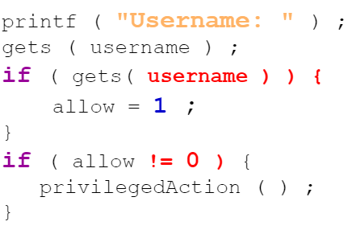
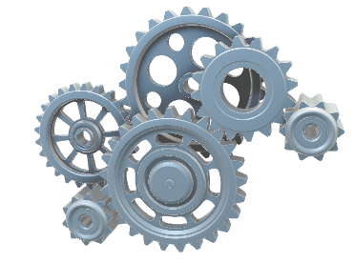
PLBART – Jointly Learning to Understand and Generate
Token Infilling
PLBART
Notes:
Token infilling is similar to token deletion, only difference is that, instead of one token, we delete a span of tokens.
And like before, we expect the decoder to generate the whole code including the deleted span.

Slide 47
PLBART – Pretraining
Noise Properties
Mutate Natural Channel
Likely to Break Syntax
Training Objectives
Generate the whole code.
Learns syntax implicitly
Learn Coding Patterns.
Multi-lingual Training
Java
Python
NL from Stack overflow
47
Notes:
Like we discussed before the noises in PLBART are the mutation of code’s natural channel. and likely to break the syntax of the code.
And the training objective is to generate whole code, learn the syntax implicitly and learn coding patterns.
We pretrained PLBART on source code examples in Java and Python and Natural language texts from stackoverflow.

Slide 48
PLBART
Evaluation
Notes:
Having discussed the technical details of PLBART, let us move onto evaluation.

Slide 49
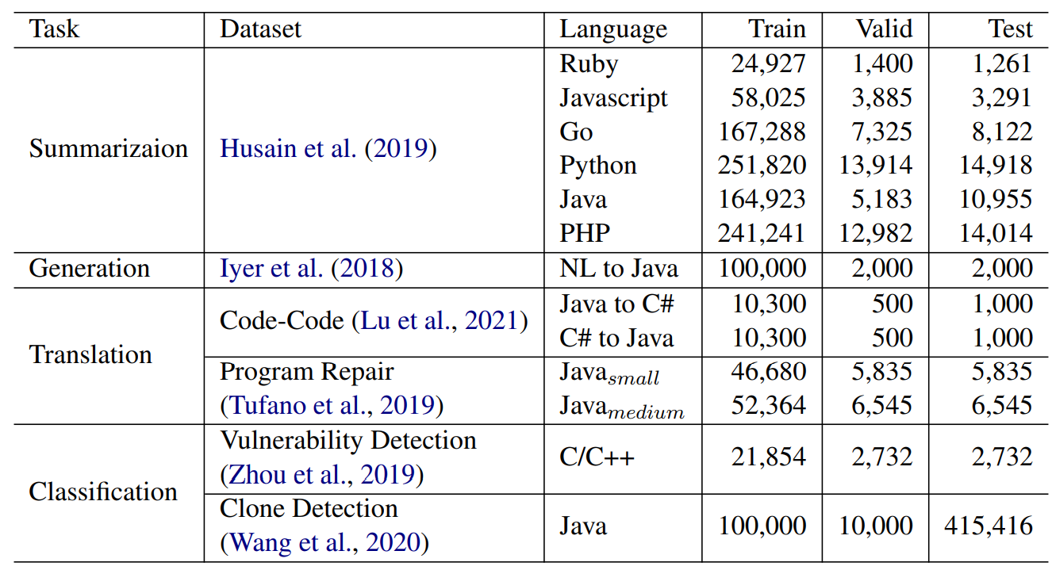
Downstream Tasks
Notes:
First, these are the downstream SE tasks we evaluated PLBART on.
While we evaluated PLBART on five different types of downstream SE related tasks, today I am going to discuss the results of Program Repair in PLBART

Slide 50

Code Editing (Program Repair) Result
Dataset: Bugfix dataset, Tufano et. al. 2019 [7] – Abstract Edit
Metric: EM (exact match) in Top-1 position
Small - Upto 50 Tokens
Medium - 51-100 tokens
Small
Medium
Notes:
For Program Repair task, PLBART generates

Slide 51


Developers Guidance
Context
Notes:
Further, if we look at this code snippet, from the guidance, we get a hint that there should be a check of empty object. But which object we should check for, we have no clue.
However, if we look at the context, we get an idea that
The jsonObject should be checked for being empty.
Thus, context could be a major help for finding code element while synthesizing the patch.

Slide 52
MODIT : Multi-Modal Learning of Editing Source Code
ASE 2021
Findings
Developer Guidance and Context of Edit are very important for Automated Code Editing.
Contribution
Leveraging multiple information modalities to Automate Code editing, and identification of best way of processing such modalities.
Notes:
With these motivations, I am proposing MODIT : Multi-Modal Learning of Editing Source Code as my next and final component of my dissertation. The contribution I am proposing through MODIT are

Slide 53


MODIT : Multi Modal Code Editing (overview)
Encoder
Decoder
Notes:
With the intuitions, we built a multi modal code editing engine Modit, which works on three different modalities. Our First modality is, the code that needs to be edited. Our second modality is the the context of the edit, and last but not the least, the guidance in the form of text. We solve the problem as Encoder decoder based method.
First we concatenate the input modalities an for input to the Encoder
And then a decoder is used to generate the edited code.

Slide 54

MODIT : Multi Modal Code Editing (pipeline)
PLBART
Notes:
More specifically, given the input modalities
We concatenate and tokenize them
Then we use a transformer based encoder decoder
Finally, we take the decoder output and post process then to generate the final edited code. Now let us move on to the the experiments.

Slide 55
MODIT
Evaluation
Notes:
Having discussed the technical details of PLBART, let us move onto evaluation.

Slide 56

Experiments
Dataset (Tufano et. al. ICSE 2019 [7]) – Concrete Edits
Notes:
We evaluated MODIT on two different dataset. These datasets are proposed by Tufano et. al. at ICSE 2019. These are bug fix commits collected from GitHub. Each examples comes with a code before a commit, code after a commit and the commit message. Since getting real textual guidance for evaluation is difficult, we used commit message as a surrogate for guidance.

Slide 57

MODIT : Result
(PLBART)
Notes:
Now, let us discuss some of the implications of the results we have observed in this research question.

Slide 58


Interesting Code Generated by PLBART
PLBART generated
Better Code
58
Notes:
This is an example of Code Translation from C# to Java,
This is the input code. PLBART translated this input C# code to
This code in Java. This is a correct translation of the original C# code.
However, a better translation would be this code.
Because If we have to write a for loop leaving
the initializer and update expression empty in java,
we would rather write a while loop. Since PLBART’s training objective does to account for these kind of semantic equivalent rewriting, PLBART often lacks such capacity.

Slide 59
Implicit Encoding
Code Modeling
Explicit Encoding
Implicit Encoding
Natural Channel Mutation
Formal Channel Mutation
Mutator
59
Notes:
This brings our next approach in pretraining model. This approach is pretraining through mutation in formal channel.

Slide 60
NatGen: Generative Pretraining by “Naturalizing” Source Code
FSE 2022
Findings
Forcing a model to edit unnatural code to re-write in a more natural way embeds developers’ natural way of writing code into the model.
Contribution
Designed a large-scale pretrained model which learned natural coding patterns from developers, with demonstrated higher performance in few shot code generation.
Notes:
With these motivations, I am proposing MODIT : Multi-Modal Learning of Editing Source Code as my next and final component of my dissertation. The contribution I am proposing through MODIT are

Slide 61
NatGen: Generative pre-training by “Naturalizing” source code
Write Semantic / Functional Equivalent Code in “More Natural” way
61
Notes:
Our pretraining objective here is to rewrite a code in a way that makes it more natural, preserving the semantics and functionality of the input code.

Slide 62

NatGen: Generative pre-training by “Naturalizing” source code
De-Naturalizing Transformation
62
Notes:
In order to achieve this, we defined several de-naturalizing transformation, to transform a developer written code to make it unnatural and weird.

Slide 63



NatGen: De-Naturalizing Transformations
Confusing Statements [17]
Dead Code Insertion
Operand Swap
[21] Gopstein et. al. 2020
63
Notes:
Here are some examples of denaturalizing transformations we used.
For instance, we used dead code insertion, and asked the model to remove the dead code. Our hypothesis is that, model will learn to implicitly reason about the liveness of the code.
We also add confusing statements and
Swap the arguments of expressions, etc. Nevertheless,

Slide 64


NatGen: Generative pre-training by “Naturalizing” source code
Encoder
Decoder
NatGen - Pretraining
NatGen – FineTuning for code Editing
64
Notes:
Then given that weird unnatural code,
We pretraine an encoder decoder model to generate the original natural version. I would like to emphasize here that, the transformations we used to de naturalize code, are all semantic preserving transformations, thus the unnatural code is still syntactically and semantically correct. Arguably, this is a harder task for the models and our expectation is that model will learn how to write better code based on this hard task.

Slide 65
NatGen
Evaluation
Notes:
Having discussed the technical details of PLBART, let us move onto evaluation.

Slide 66




NatGen: Code Generation By Pretrained Models
Model | Syntax Match (%) | Dataflow Match (%) | CodeBLEU (%) | Direct Copy (%) | Avg. Edit Distance
CodeT5[18] | 13.83 | 23.67 | 10.87 | 0 | 65
PLBART | 73.17 | 75.95 | 74.56 | 7.05 | 3
NatGen | 98.16 | 96.85 | 96.82 | 0.01 | 10
[18] Wang et al. 2021
66

Slide 67

NatGen: Automated Code Editing Result
BugFix dataset proposed by Tufano et al. (ICSE 2019) [7]
Exact Match accuracy (%) at Top 1 recommendation.
67

Slide 68


NatGen: Automated Code Editing Result
Zero-Shot
Few-shot (200 training examples)

Slide 69

NatGen: Automated Code Editing Result
Number of Training Examples

Slide 70
Explicit Encoding – Take Aways
Pros
Little overhead
Cons
No Guarantee
Unsupervised
Transferable
Potential Bias from Mutation
Pretraining needs massive resource
Code Modeling
Explicit Encoding
Implicit Encoding
Natural Channel Mutation
Formal Channel Mutation
70
Notes:
Nevertheless, advantage of Implicit encoding includes very little overhead, unsupervised and transferable nature of such.
On the other hand, there is no guarantee of the learned knowledge because of the opaque nature of the large scale models. And there could be potential biases from the mutations.

Slide 71






Dissertation Summary
Explicit Encoding
Syntax
Code Modeling
Explicit Encoding
Implicit Encoding
Natural Channel Mutation
Formal Channel Mutation
Ways of Encoding
Implicit Encoding
Semantics
Large Data Corpus
71
Notes:
Nevertheless, advantage of Implicit encoding includes very little overhead, unsupervised and transferable nature of such.
On the other hand, there is no guarantee of the learned knowledge because of the opaque nature of the large scale models. And there could be potential biases from the mutations.

Slide 72
List of Publications
NatGen: Generative pre-training by" Naturalizing" source code - S Chakraborty, T Ahmed, Y Ding, P Devanbu, B Ray. The ACM Joint European Software Engineering Conference and Symposium on the Foundations of Software Engineering (ESEC/FSE 2022).
Towards Learning (Dis)-Similarity of Source Code from Program Contrasts - Y Ding, L Buratti, S Pujar, A Morari, B Ray, S Chakraborty Proceedings of the 60th Annual Meeting of the Association for Computational Linguistics (ACL’22).
On Multi-Modal Learning of Editing Source Code - S Chakraborty, B Ray 2021 36th IEEE/ACM International Conference on Automated Software Engineering (ASE’21).
Retrieval Augmented Code Generation and Summarization - MR Parvez, WU Ahmad, S Chakraborty, B Ray, KW Chang Findings of the Association for Computational Linguistics 2021 (ENMLP).
Deep learning-based vulnerability detection: Are we there yet? - S Chakraborty, R Krishna, Y Ding, B Ray IEEE Transactions on Software Engineering (TSE’21).
Unified Pre-training for Program Understanding and Generation - WU Ahmad, S Chakraborty, B Ray, KW Chang Annual Conference of the North American Chapter of the Association for Computational Linguistics (NAACL’21).
CODIT: Code editing with tree-based neural models - S Chakraborty, Y Ding, M Allamanis, B Ray IEEE Transactions on Software Engineering (TSE’20).
A transformer-based Approach for Source Code Summarization - W Ahmad, S Chakraborty, B Ray, KW Chang Association for Computational Linguistics (ACL’20).
Toward optimal selection of information retrieval models for software engineering tasks - MM Rahman, S Chakraborty, G Kaiser, B Ray 2019 19th International Working Conference on Source Code Analysis and Maintenance (SCAM’19).
Building language models for text with named entities - MR Parvez, S Chakraborty, B Ray, KW Chang 56th Annual Meeting of the Association for Computational Linguistics (ACL’18).
Which similarity metric to use for software documents? A study on information retrieval-based software engineering tasks - MM Rahman, S Chakraborty, B Ray Proceedings of the 40th International Conference on Software Engineering (ICSE’18).
72
Notes:
Nevertheless, advantage of Implicit encoding includes very little overhead, unsupervised and transferable nature of such.
On the other hand, there is no guarantee of the learned knowledge because of the opaque nature of the large scale models. And there could be potential biases from the mutations.

Slide 73





My Research Applications
Programming Language Processing
Code Summarization
NeuralCodeSum (ACL’20), PLBART (NAACL’21)
Vulnerability Detection
ReVeal(TSE’21), DISCO(ACL’22)
Code Editing
CODIT (TSE’20), MODIT(ASE’21), DiffBERT (Facebook)
PLP
Code Generation
PLBART (NAACL’21), DataTypeLM ForCode (ACL’18).
Code Search and Synthesis
RedCoder (EMNLP’21), CodePanda (W.I.P)
73
Notes:
Now to summarize, I have applied my research in Programming Language Processing in different applications. including
Code summarization
Vulnerability Detection
Code Editing
Code generation and translations
And finally Code Search and Synthesis

Slide 74





Future Plan (Short Term Goal)
API driven Program Synthesis
Improving Semantic Code Search with RL
Synthesizer
I/O Similarity
74
Notes:
I am currently working on several projects. Including API driven program synthesis
And Improving Semantic Code Search with RL.

Slide 75


Future Plan (Short Term Goal)
Representing Code Context as Dynamic Graph
Learning Code Syntax and Semantics with Reinforcement Learning (RL)
Other Information Modalities
Other Software Metadata – Comments, Commits, Code Evolution metadata.
Analysis of Program Binaries.
Dynamic Analysis of Program – based on execution behavior.
75
Notes:
In Near future I plan to work in learning syntax and semantic through RL
Learning to represent Code context as a hierarchical dynamic graph.
My another short term goal is investigate other modes of code, for examples, meta data, binaries, traces, etc.

Slide 76







Future Plan (Long Term Goal)
Code Generation
Formal Analysis
Probabilistic models
Guarantee for the Analysis
Scalable and Transferrable
Noise Intolerant
No theoretical Guarantee
Developer Feedback Oriented Automation
76
Notes:
In long term, my goal is to work on pushing the
boundary of code generation by moving simultaeneously from formal analysis perspective and probabilistic models’ perspective.
And meet somewhere in the middle of the spectrum.
My another long term goal is to incorporate developers’ feedback into the model and further improving the model by rewarding or penalizing based on the feedback from developers.

Slide 77











Baishakhi Ray
Adviser
Wasi Ahmad
UCLA / Amazon
Miltos Allanmanis
MSR
Kai-Wei Chang
UCLA
Gail Kaiser
Columbia University
Prem Devanbu
UC Davis
Yangruibo Ding
Columbia
Masudur Rahman
Uva/Purdue
Rahul Krishna
Columbia / IBM
Toufiq Parag
UC Davis
Rizwan Parvez
UCLA
77

Slide 78
References
[1] Meng, Na, Miryung Kim, and Kathryn S. McKinley. "Systematic editing: generating program transformations from an example." ACM SIGPLAN Notices 46.6 (2011): 329-342.
[2] Meng, Na, Miryung Kim, and Kathryn S. McKinley. "LASE: locating and applying systematic edits by learning from examples." 2013 35th International Conference on Software Engineering (ICSE). IEEE, 2013.
[3] Ray, Baishakhi, et al. "The uniqueness of changes: Characteristics and applications." 2015 IEEE/ACM 12th Working Conference on Mining Software Repositories. IEEE, 2015.
[4] Rolim, Reudismam, et al. "Learning syntactic program transformations from examples." 2017 IEEE/ACM 39th International Conference on Software Engineering (ICSE). IEEE, 2017.
[5] Dinella, Elizabeth, et al. "Hoppity: Learning graph transformations to detect and fix bugs in programs." International Conference on Learning Representations (ICLR). 2020.
[6] Tufano, Michele, et al. "An empirical investigation into learning bug-fixing patches in the wild via neural machine translation." Proceedings of the 33rd ACM/IEEE International Conference on Automated Software Engineering. 2018.
[7] Tufano, Michele, et al. "On learning meaningful code changes via neural machine translation." 2019 IEEE/ACM 41st International Conference on Software Engineering (ICSE). IEEE, 2019.
[8] Tufano, Michele, et al. "An empirical study on learning bug-fixing patches in the wild via neural machine translation." ACM Transactions on Software Engineering and Methodology (TOSEM) 28.4 (2019): 1-29.
[9] Chen, Zimin, et al. "Sequencer: Sequence-to-sequence learning for end-to-end program repair." IEEE Transactions on Software Engineering 47.9 (2019): 1943-1959.
[10] Tufano, Rosalia, et al. "Towards automating code review activities." 2021 IEEE/ACM 43rd International Conference on Software Engineering (ICSE). IEEE, 2021.
[11] Feng, Zhangyin, et al. "CodeBERT: A Pre-Trained Model for Programming and Natural Languages." Findings of the Association for Computational Linguistics: EMNLP 2020. 2020.
78
Notes:
Nevertheless, advantage of Implicit encoding includes very little overhead, unsupervised and transferable nature of such.
On the other hand, there is no guarantee of the learned knowledge because of the opaque nature of the large scale models. And there could be potential biases from the mutations.

Slide 79
References
[12] Lutellier, Thibaud, et al. "Coconut: combining context-aware neural translation models using ensemble for program repair." Proceedings of the 29th ACM SIGSOFT international symposium on software testing and analysis. 2020.
[13] Allamanis, Miltiadis, Marc Brockschmidt, and Mahmoud Khademi. "Learning to Represent Programs with Graphs." International Conference on Learning Representations. 2018.
[14] Yin, Pengcheng, et al. "Learning to Represent Edits." International Conference on Learning Representations. 2018.
[15] Zhou, Yaqin, et al. "Devign: Effective vulnerability identification by learning comprehensive program semantics via graph neural networks." Advances in neural information processing systems 32 (2019).
[16] Guo, Daya, et al. "GraphCodeBERT: Pre-training Code Representations with Data Flow." International Conference on Learning Representations. 2020.
[17] Chen, Mark, et al. "Evaluating Large Language Models Trained on Code." (2021).
[18] Wang, Yue, et al. "CodeT5: Identifier-aware Unified Pre-trained Encoder-Decoder Models for Code Understanding and Generation." Proceedings of the 2021 Conference on Empirical Methods in Natural Language Processing. 2021.
[19] Casalnuovo, Casey, et al. "A theory of dual channel constraints." 2020 IEEE/ACM 42nd International Conference on Software Engineering: New Ideas and Emerging Results (ICSE-NIER). IEEE, 2020.
[20] Karampatsis, Rafael-Michael, et al. "Big code!= big vocabulary: Open-vocabulary models for source code." 2020 IEEE/ACM 42nd International Conference on Software Engineering (ICSE). IEEE, 2020.
[21] Gopstein, Dan, et al. "Thinking aloud about confusing code: A qualitative investigation of program comprehension and atoms of confusion." Proceedings of the 28th ACM Joint Meeting on European Software Engineering Conference and Symposium on the Foundations of Software Engineering. 2020.
79
Notes:
Nevertheless, advantage of Implicit encoding includes very little overhead, unsupervised and transferable nature of such.
On the other hand, there is no guarantee of the learned knowledge because of the opaque nature of the large scale models. And there could be potential biases from the mutations.

Slide 80
Thanks!
80
Notes:
Thanks for attending the talk, I will be happy to answer any further questions.

Slide 81
Backup Slides

Slide 82
CODIT Step 1 : Tree Translation
82
Notes:
In the first step of CODIT, our goal is to translate the structure of the code. Our motivation to do such is if we can generate structure of the edited code, we don’t have to worry about the syntactic correctness. Nevertheless, let us see how to achieve such translation.

Slide 83




CODIT Step 1 : Tree Translation
83
Notes:
Our first challenge is to encode the syntax tree so that it is consumable by a model. To encode the syntax tree, we flatten out the tree STRUCTURE as a sequence of production rules from the context free grammar of the programming language. These rules,
If applied sequentially
To the root node in a left derivation fashion would generate the syntax structure
Of the corresponding code.

Slide 84
CODIT Step 1 : Tree Translation
Rules sequence of
Syntax Tree before edit
Rules sequence of
Syntax Tree after edit
84
Notes:
Once we have the rules corresponding to the before version and the after version, we use sequence to sequence translator to translate these rule sequence.

Slide 85





CODIT Step 1 : Tree Translation
85
Notes:
From those generated rule sequence by the rule translator, Codit takes one rule at a time and grows the syntax tree in leftmost derivation fashion.
At every step, CODIT expands the leftmost bottommost non terminal node.
At any point, if the rule head does not match with the node to be expanded,
codit can ignore that rule, or chose an alternative one.
Codit stops when there are no more non-terminal node to be expanded. That is the tree is fully grown.

Slide 86
ReVeal: Program Understanding through Explicit Program Encoding
TSE - 2021
Findings
Graph-based models are better equipped to understand semantic relationships between code components
Contribution
Designed Code Understanding Framework using Graph-Based Models.
Notes:
The first component of my dissertation is CODIT: Code Editing with tree based neural models published in TSE 2020
Our major finding in this paper is the Generation of Syntax Tree instead of code Guarantees Syntactic Correctness. And it can be achieved with the help of Context Free Grammar of the Programming Language.
Our major contribution in this paper is that we designed a hierarchical Syntax Tree based model for learning code edit patterns.

Slide 87






ReVeal : Explicit Encoding for Program Understanding
Training Data
Node Features
GGNN
Code Property Graph
Trained ReVeal
Graph Embedding
Notes:
We designed Reveal, a graph based tool to detect vulnerabilities in real world software projects.
Given training data containing vulnerabile and non-vulnerable code, we extract code property graph, which is a graph that encodes all structural relationships between code components.
From the code property graph, we extract initial node features for every node.
Then we use Graph Neural Network to learn the node features from the graph structure.
Once node features are learned, we aggregate those to generate a graph level features
Given a collection of such graph level features, we do resampling to reduce the imbalance bias,
and train our tool ReVeal

Slide 88


ReVeal : Explicit Encoding for Program Understanding
ReVeal
F1 score
Token
Based
Graph
Based
[15]
Token
Based
Graph
Based [15]
Chromium & Debian
FFMpeg & Qemu
[15] Devign Zhou et. al. 2019
Notes:
We evaluated ReVeal’s ability to detect vulnerability in two real world vulnerability datasets. The evaluation results show us that
ReVeal and Another Graph Neural Network based model
Devign exhibit higher performances than that of Token based models.

Slide 89





Explicit Encoding PL knowledge into model
Code Property Graph
89
Notes:
If we look closely, In this code understanding task, our input is a code property graph, thus we had to adapt a model that consumes graph. In addition to this, we had to customize the model node embedding based on the content, edge embedding based on type, etc. All of these are PL specific properties, and we are encoding these with a large amount of customization of the model.

Slide 90

PLBART Results
Code Summarization

Slide 91

PLBART Results
Code Generation from Natural Language

Slide 92

PLBART Results
Code Translation

Slide 93

PLBART Results
Code Classification - % Accuracy for Vulnerability, F1 score for Clone Detection.

Slide 94

Code Translation Example
Notes:
Here is an example of code translation using PLBART, This C# code is correctly translated to Java code by PLBART.
However, there are some more subtle and interesting example to note here.
First of all, visually, we can say that PLBART learns to both understand and generate code. Since the input is a code, the model needs to understand that, and the output is another code, thus PLBART definitely learned to generate code.
Furthermore, PLBART learns about semantics, … (describe the semantic of iteration)
Another interesting thing to note here
And last but not the lease, Style.
With that I conclude today’s talk reviewing the state of the art techniques for use of ML in different SE tasks.
I will be happy to answer any question you might have now.

Slide 95



Notes:
Suppose a software developer wants to modify their code.
In particular, they want to change this line. Now, this line can be changed in many different ways.
For instance, the ArrayList can be replaced by either the hashset or
It can be replaced with LinkedList.

Slide 96

Notes:
Now the machine working for the developer is confused. The machine does not know which one to take, both of them are syntactically and semantically correct.

Slide 97

Notes:
Then the developer tells the machine about their intention as a guidance.

Slide 98

Notes:
Now the machine can decide, this is the correct patch, not the other one. And the developer is happy

Slide 99

Transformers can learn syntax
Notes:
So, the takeaway points from the results in this research question are,
Transformers are robust enough to learn the syntax without explicit syntactic supervision. Thus, the transformer models outperforms the CODIT model.

Slide 100
Pretrained models improves Code editing
Notes:
The second takeaway is, pretrained models improve the performance.
As we can see here, approached that use pretrained models results in significantly higher performance than models that are trained from scratch.

Slide 101
Multi Modality Improves Code Editing
Notes:
And last but not least, Multi Modality improves code editing performance irrespective of what pretrained model we use.
As we can see, no matter
What model
We use
Multi modality always helps.

Slide 102

Impact of Different Information Modality.
Notes:
In the next research question, we evaluated the effect of three different modalities.
If we remove the Context from MODIT’s pipeline, the performance decreases from full MODIT
If we remove Guidance, the performance also decreases.
If we remove both the context and guidance, the performance fall even more.
We did another experiment, where we only took the context. This settings is similar to SequenceR proposed by Chen et. al. (TSE 19).
Even there, the guidance improves the performance. Now, let us look at some qualitative examples similar to the one we saw at the beginning of the talk.

Slide 103

Impact of Different Information Modality.
Impact of Guidance
Notes:
As we can see here, without the guidance, MODIT generates an incorrect patch.
But with the guidance model is able to predict correctly.

Slide 104

Impact of Different Information Modality.
Impact of Context
Notes:
In this example, MODIT generates a wrong patch without the context.
MODIT is able to generate right patch with the context, since the variable for the right patch, that is the variable sent is actually present in the context. With the results, we conclude that, both the guidance and the context are necessary to successfully generate edited code.

Slide 105

Best way to encode input Modalities.
R. Tufano et. al. - ICSE 2021
Notes:
An alternate approach could be using three different encoders to encoder three input modalities. This approach is similar to what Rosalia Tufano et.al. proposed in their ICSE 2021 paper.

Slide 106

Best way to encode input Modalities.
Notes:
We did two different experiments to understand the effect of the number of encoders
First, we use all three modalities, and used three encoders for each. As we can see single encoder results in the best performance.
Second, we take just the code before edit, that is ep and the guidance that is G. As we see, in this case as well, single encoder results in the best performance.

Slide 107


Best way to encode input Modalities.
Notes:
As we know transformer models learn representation with attention between all tokens in the input. When we use different encoders for different inputs, it can only learn within the input. For instance, here, X1 depends only on X2. Y1 depends only on Y2, There is no chance for interaction between Xs and Ys.
However, when we use one single encoder for all the input modalities, the model learns the representation with respect to other modalities as well. In this case, X1 not only depends on X2, but also on Y1 and Y2. Thus we conclude single encoder results in better representation.

Slide 108

NatGen Results
NL to Code Generation

Slide 109

NatGen Results
Code Translations

Slide 110

NatGen Results
Code Summarization

Slide 111

NatGen Results
Zero Shot Learning

Slide 112

NatGen Results
Few Shot Learning

Slide 113

NatGen Results
Few Shot - Ablation

Slide 114

NatGen Results
Few Shot - Ablation

Slide 115

Code Before Edit
Code After Edit
Language Model
Edit Model
Language Model
Notes:
Let us look at the idea behind this work. In general terms, For a model that transforms an input to output of code editing task
there are two sub tasks. A portion of the model understands the input and generates the output, and another portion reasons about the Edit patterns.
In another word, the first part is more of a Language model, the second part is more of a edit model.Though, these two parts of a model are not explicit and often these parts interact with each other, we can conceptually subdivide any model in this way. So far, we have seen that we trained these two parts together.
However, the language model, that is the portion of the model that learns to understand and generate the language does not depend on the code editing task.

Slide 116
Pretraining - Embed the knowledge of input and output into the model.
Notes:
A very similar idea to embed the knowledge about the input and the output into the model is Pretraining. That is, we can train a pre-train a model how to understand the source code, and how to generate source code. One very important thing to note here is that, Like I mentioned before learning to understand or learning to generate code does not depend on the task. That is, for pretraining a model how to read or write code, we do not need example edits. There are billions of lines of code in guthub and in other open source repositories, which we can use for pretraining such a model. Of course, the objective of such pre-training is like teaching the model what is a source code, what is the syntax, how to write a for look, how to catch exception etc.

Slide 117
PLBART - Pretraining both encoder and decoder.
Encoder
Decoder
What Type of Model should we use?
Notes:
Thus, we come up with and encoder decoder model which we pre-trained for simultaneously understanding code and learning to generate code. However, there are few design decisions that we had to consider
Choice of model - Transformer Model
Pre-training Training Objective

Slide 118


Recurrent Model Vs. Transformer Model
Recurrent Model
2. Transformer Model
T4
Notes:
Before deciding the choice of model in PLBART, let us recap on conceptual view of recurrent models and transformer models. And see how transformer model itself solves some of the problems in recurrent model.
Recurrent model processes one token at a time. While processing a tokens It depends on the input and its internal state.
As we can see here, There is not direct connection between T1 and T4.
T4 knows about the information about T1 through the internal state of the RNN.
1click
2click
3click
In contrast, in Transformer model,
every token are softly connected to each other. Conceptually, transformer is a fully connected graph, where nodes are tokens in a sentence, and edges are attention weights between the tokens.
As part of the training process, the nodes learn which token depend on what other tokens and by how much.
Since every token could be connected to every other tokens, the transformer is able to learn very long range dependency.
For instance, here T4 directly gets T1’s information since they are directly connected.
Moreover Transformer also model multi-head attention, which is conceptual equivalent to having multiple dependency edges between components of code. Since Transformer implicitly models the input as a graph with provision for multiple type of edges through attention, we believe that Transformer is the right choice of model for PLBART.

Slide 119






Notes:
Given this noisy input,
The encoder generates representation for each token position.
The Decoder then generates sequentially one token at a time.
But while generating, the decoder puts attention
To the encoder’s representation as well as
All previously generated tokens. Since the encoder generates representation in such a way that also understands any noisy token, the encoder must’ve learned to understand the structure of the code, even when some part of the code are not correct.
And since the decoder is also being able to generate noisy tokens, it is not just memorizing from the encoder, it is also learning to reason about what token come after what. That is the decoder is learning to generate syntactically and contextually correct code.

Slide 120

BERT - Pretrained Transformer Encoder
Pre-training:
Task agnostic Masked Language Model.
CuBERT - Kanade et. al. 2020.
CodeBERT - Feng et. al. 2020.
GraphCodeBERT - Guo et. al. 2021
SE usage: Better Suitable for Understanding Code.
Notes:
Pretraining model is task agnostic way has recently received a lot of attraction specially in the industry. Several works from Microsoft Research and Google Brain published pre-training transformer based encoder for source code analysis task. All these works are based on BERT, which is a pretrained transformer encoder. The objective of BERT is a masked language model. That is some random words are masked out in a sentence, and model is asked to predict those words. While predicting these tokens, model learn how that token is related to other tokens in the sentence. In another word, the model learn the structure of the sentence, interaction between different components of the sentence.
This BERT model is pretrained using task agnostic masked language mdoel.
Since this model learns to reason about the components of the input, this model is very suitable for Understanding source code in SE domain.
In SE domain, there are three prominent models that uses BERT like architecture with slightly different pretraining objective. Those models are CuBERT from Google brain, CodeBERT and GraphCodeBERT from Microsoft Research. While BERT is designed to understand code, how may we use BERT for Code Editing task.

Slide 121

Knowledge about generation is not embedded in Decoder.
Notes:
For Code Editing task, a transformer based decoder is added with a pretrained bert, which is trained from scratch to generate edited code. Since the decoder is trained from scratch, Knowledge about generation is not embedded in Decoder.

Slide 122



CodeBERT vs. CodeGPT vs. PLBART
BERT
GPT
PLBART
Notes:
Now let us discuss what are the differences between CodeBERT, CodeGPT, and PLBART to understand why MODIT with PLBART results in the best performance.
BERT is a pretrained encoder, so while using BERT in encoder-decoder settings, the decoder is randomly initialized that is the decoder is trained from scratch.
GPT, on the other hand, is a pretrained left-to-right decoder, there is no encoder in GPT. Thus, GPT model does not understand the input bidirectionally.
Finally, in PLBART, both the encoder and the decoder are pretrained. Thus, PLBART learn to understand the input, and correctly generate the output as part of pretraining process.

